Slide 1

DDCA PROJECT · KL UNIVERSITY
Simulation of an Intelligent Traffic Signal Controller Using FSM
A clocked digital controller for safe, repeatable traffic flow.
Section: 14
Team: 8
2620030353;
2620030358;
2620030358;
2620030366

Slide 2
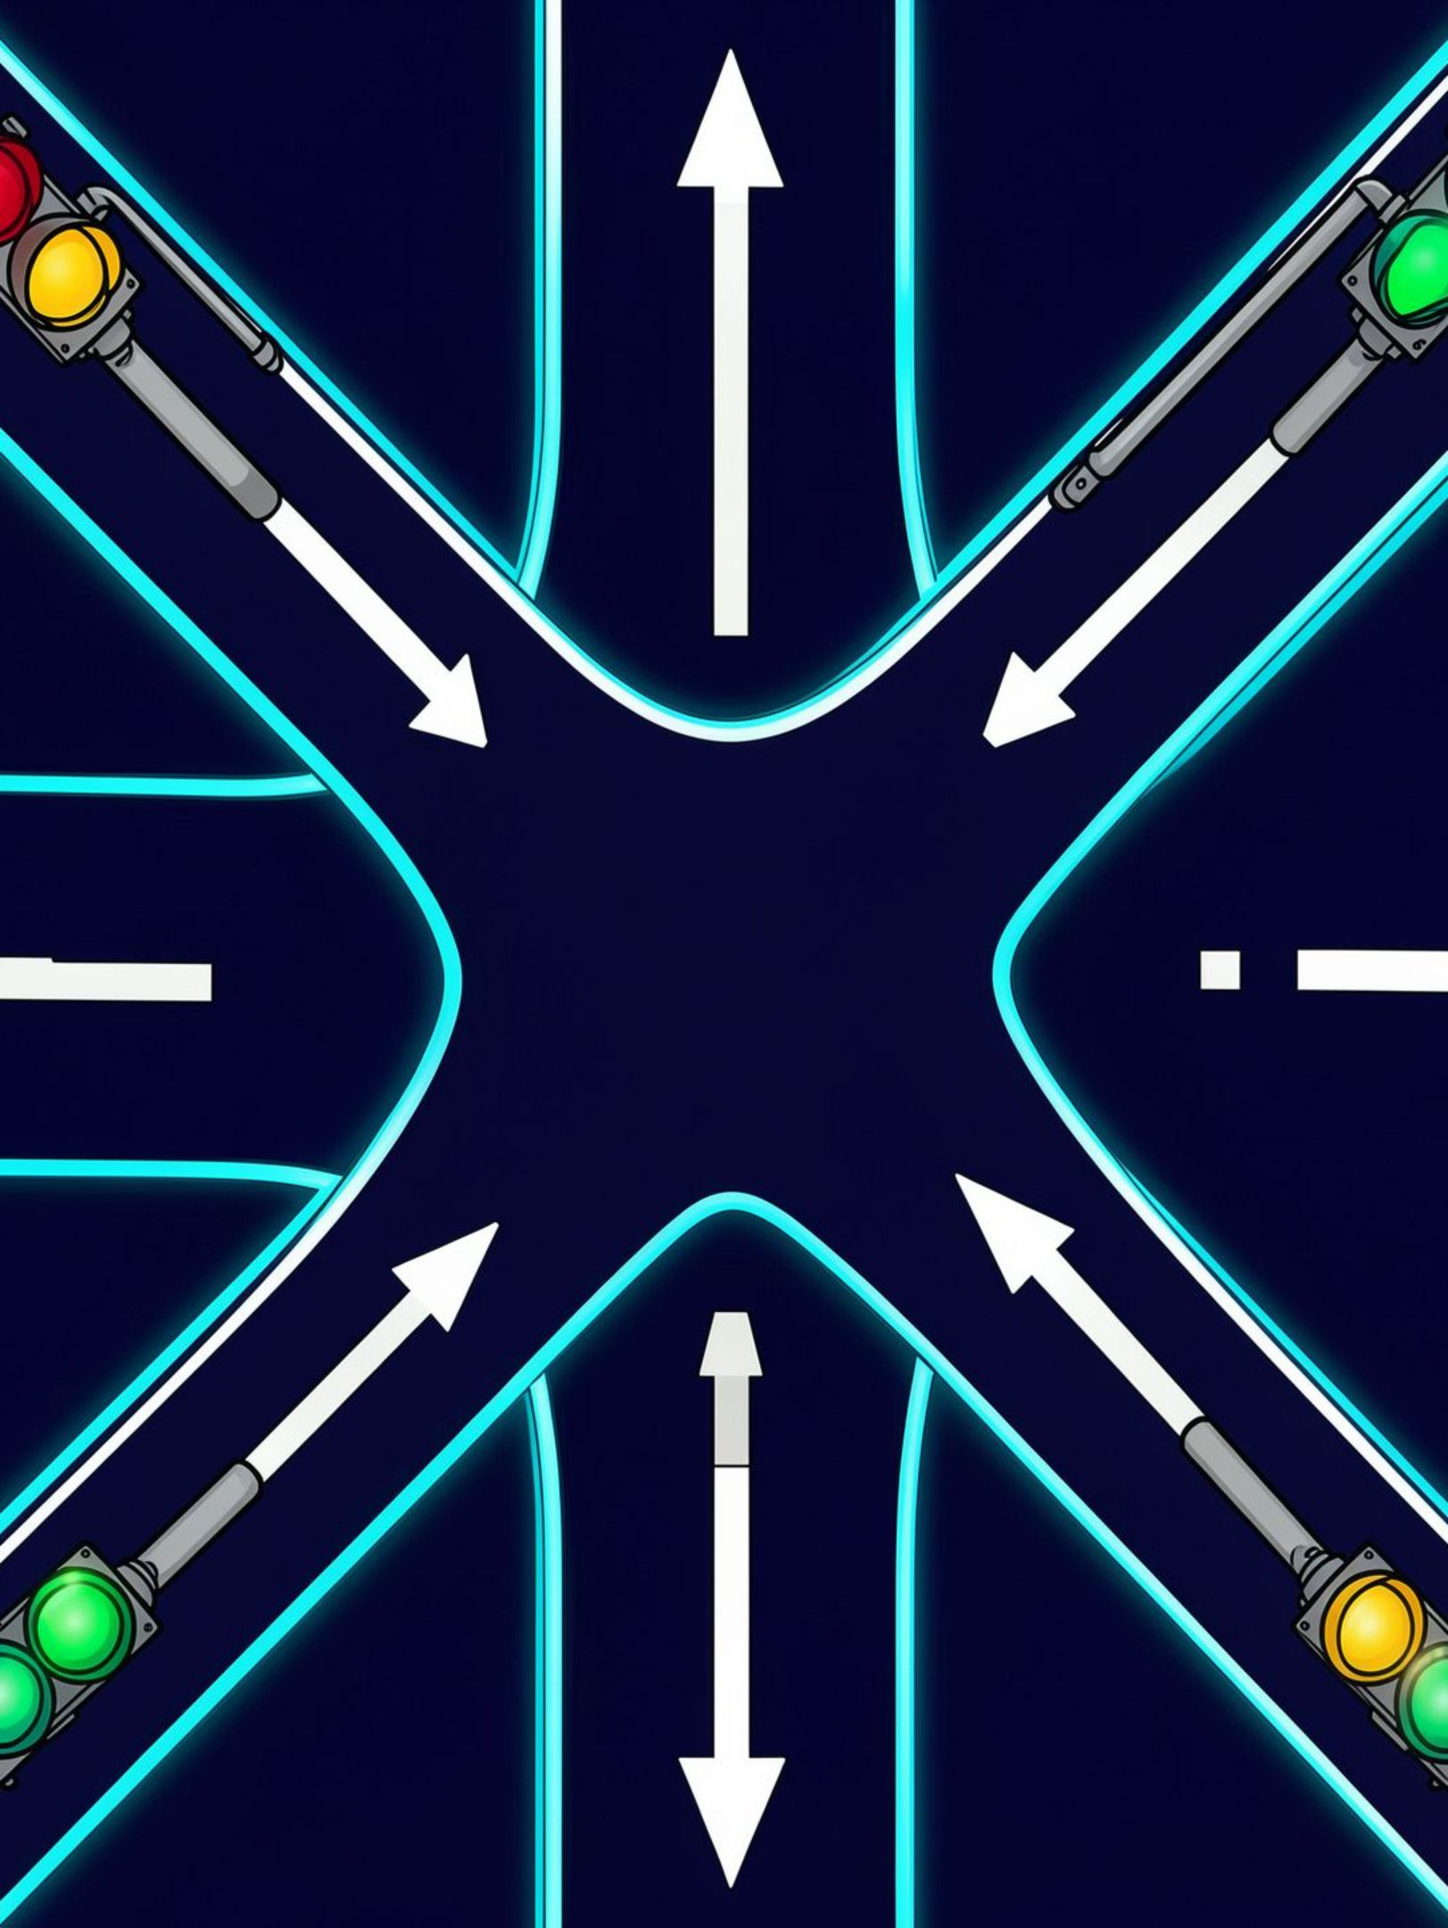



SYSTEM OVERVIEW
Safe traffic control starts with one shared clock
An intelligent traffic signal controller coordinates two intersecting roads through timed digital states.
One clock
One FSM
One safety rule
Each clock edge advances the controller in a known order.
The current state determines the next transition and outputs.
Conflicting green lights are never allowed.
Objectives: automate signal changes, control traffic flow, prevent conflicting green lights, and demonstrate digital logic in Logisim.
2

Slide 3
FINITE STATE MACHINE
Five states turn timing into safe, repeatable logic
The clock advances the FSM; D flip-flops store the state; AND, OR, and NOT gates form next-state and output logic.
S0
S2
S4
Main green · side red
Both roads red · all-red clearance interval
Main red · side yellow
S1
S3
Main yellow · side red
Main red · side green
Clocked sequence: S0 → S1 → S2 → S3 → S4 → S2 → S0
CLOCK
STATE REGISTER
NEXT-STATE LOGIC
OUTPUT DECODER
Advance
D flip-flops
AND · OR · NOT
Six lamp outputs
3

Slide 4
LOGISIM IMPLEMENTATION
Logisim implementation mirrors the FSM blocks
Each clock step exposes one state, one decoded lamp pattern, and one safe transition.
M R
S R
CLOCK
STATE REGISTER
NEXT-STATE
OUTPUT DECODER
M Y
S Y
pulse
3 D flip-flops
AND · OR · NOT
state → lamps
M G
S G
Illustrative schematic — not an actual Logisim screenshot.
4

Slide 5
Simulation results: one green road at a time
State | Meaning | Main R | Main Y | Main G | Side R | Side Y | Side G
S0 | Main green | 0 | 0 | 1 | 1 | 0 | 0
S1 | Main yellow | 0 | 1 | 0 | 1 | 0 | 0
S2 | Both red | 1 | 0 | 0 | 1 | 0 | 0
S3 | Side green | 1 | 0 | 0 | 0 | 0 | 1
S4 | Side yellow | 1 | 0 | 0 | 0 | 1 | 0
SAFETY CHECK
SIMULATION EVIDENCE
Main G = 1 and Side G = 1 never occur together.
[Insert real Logisim simulation screenshot here]
Do not label the illustrative schematic as a screenshot.
Clock edge + current state determine the next state and lamp pattern.
5

Slide 6
CONCLUSION
The controller is simple, safe, and ready to extend
Simple and safe
EXPECTED OUTCOME
A working simulation that demonstrates controlled traffic flow without simultaneous green signals.
The FSM converts clock pulses into a predictable traffic-light sequence with an all-red clearance state.
Logisim makes the state register, combinational logic, decoder, and LED outputs easy to inspect and explain.
Applications: road intersections, campus traffic systems, and digital logic education.
Future improvements: vehicle sensors, adjustable timers, pedestrian buttons, and emergency-vehicle priority.
Thank You
6

